Slide 1

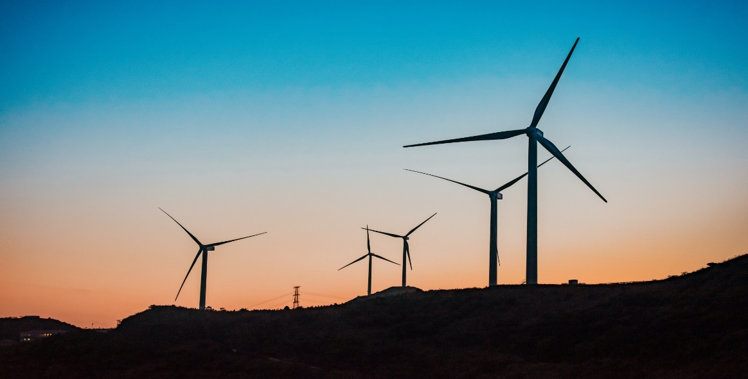

Predicting the Energy Output of wind turbine based on weather conditions
Presented By
Mrs.Puppala Ramya,
Assistant Professor,
Koneru Lakshmaiah Education Foundation,
Vijayawada, Andhra Pradesh

Slide 2

Selected Category
At
Machine Learning

Slide 3
Problem Statement
To Produce Accurate predictions of energy output from a wind farm based on the wind conditions at its surrounding .
Next 72 hrs. Prediction at time interval of 1 hr.
Build an application to recommend the Power Grid to suggest the best time to utilize the energy from wind farm

Slide 4

Why Large number of customers have the same pain?
Reality and Reliability
Cost Deduction
Forecast the wind power
Different energy sources

Slide 5
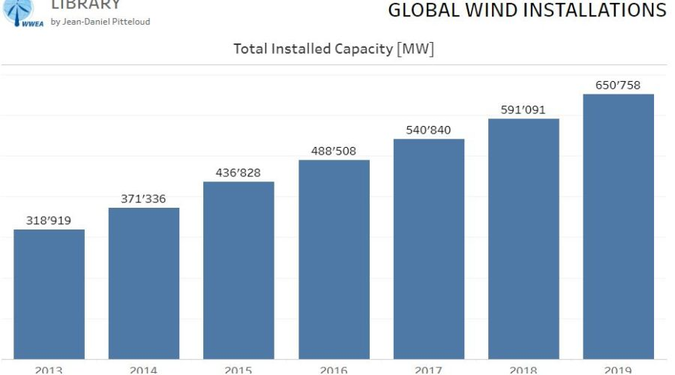
Statistics

Slide 6
Solution
TAGLINE
The breath of life is in the sunlight, and the prediction of energy is in the wind

Slide 7
Value Preposition
Easy to use
from past weather conditions and corresponding power output data
Requirs geo-coordinates of location only,not known use live location.

Slide 8
How it is feasible?
A simple Android App which uses ML model in backend which has an accuracy of 95% in predicting.
Financially feasible and so anyone can use it without the need of additional resources

Slide 9
External Flow Chart
2.Data
Collection
4.Model
Design
3.Data
Pre-processing
Developer
5.Application
Design

Slide 10
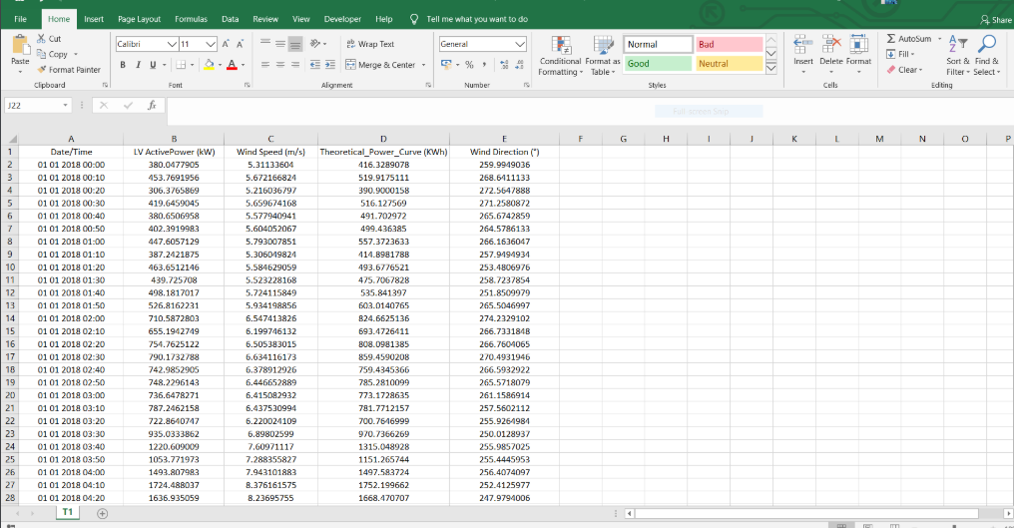
Data Collection- Kaggle Dataset

Slide 11
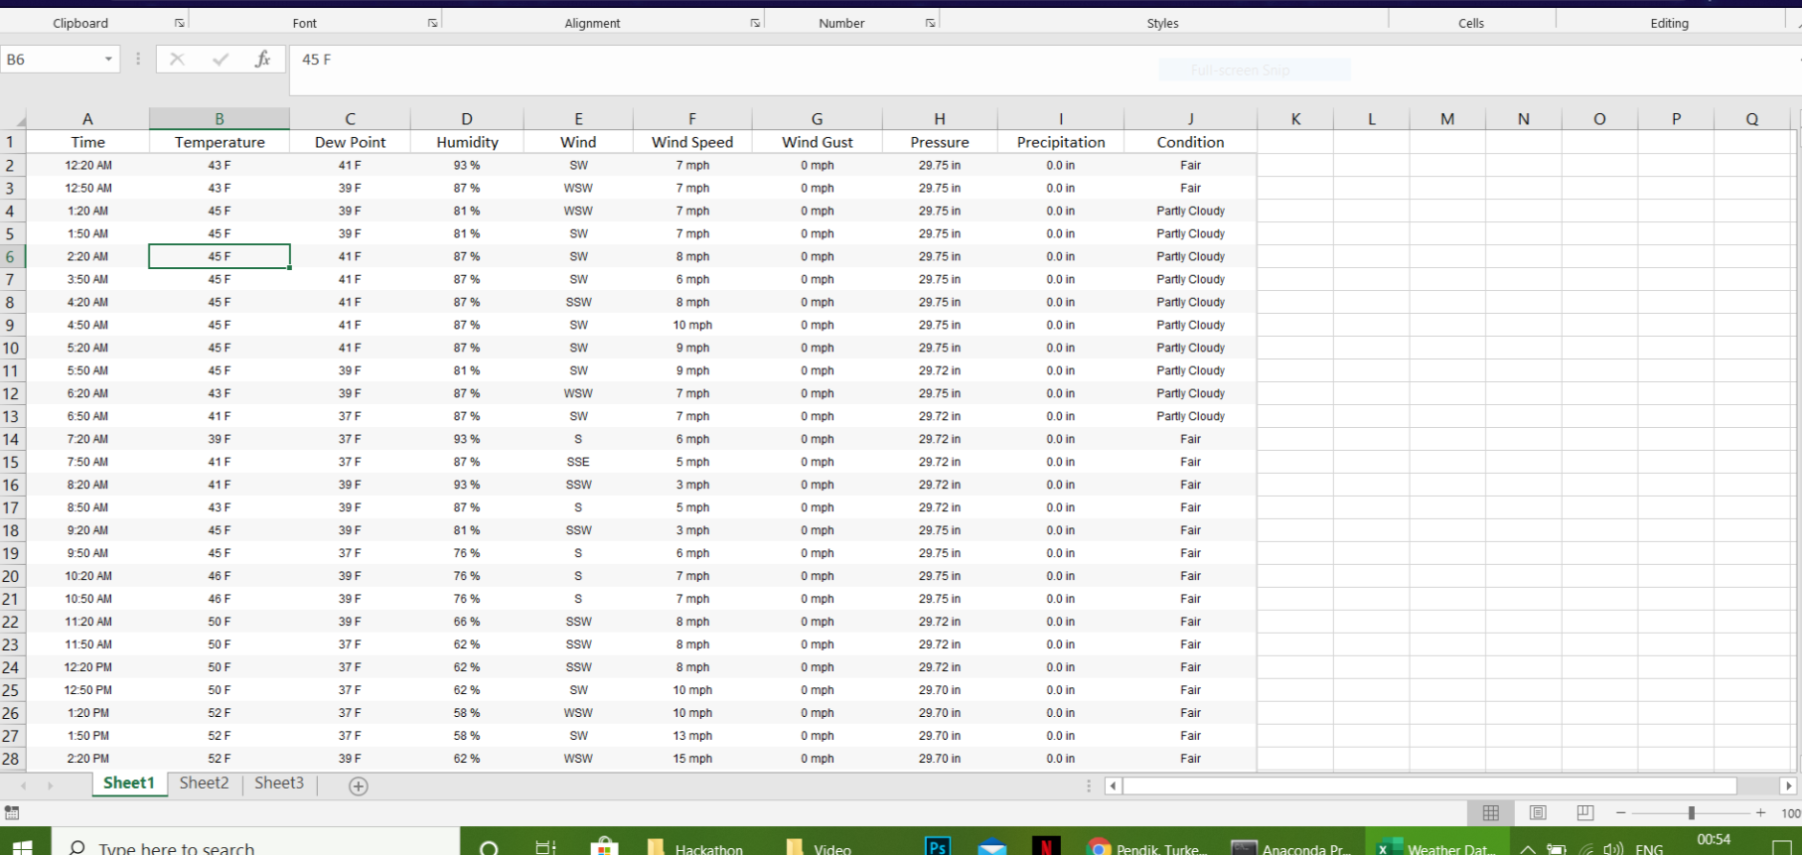
Weather Data

Slide 12
Data Preprocessing
Activity 1 : Taking care of the missing data
Activity 2 : Feature scaling
Activity 3: Visualization of the Data

Slide 13
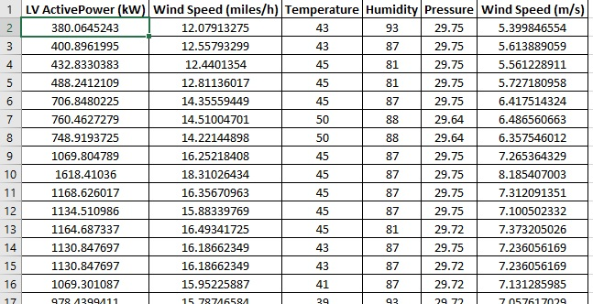
Final Dataset After Cleaning Process

Slide 14
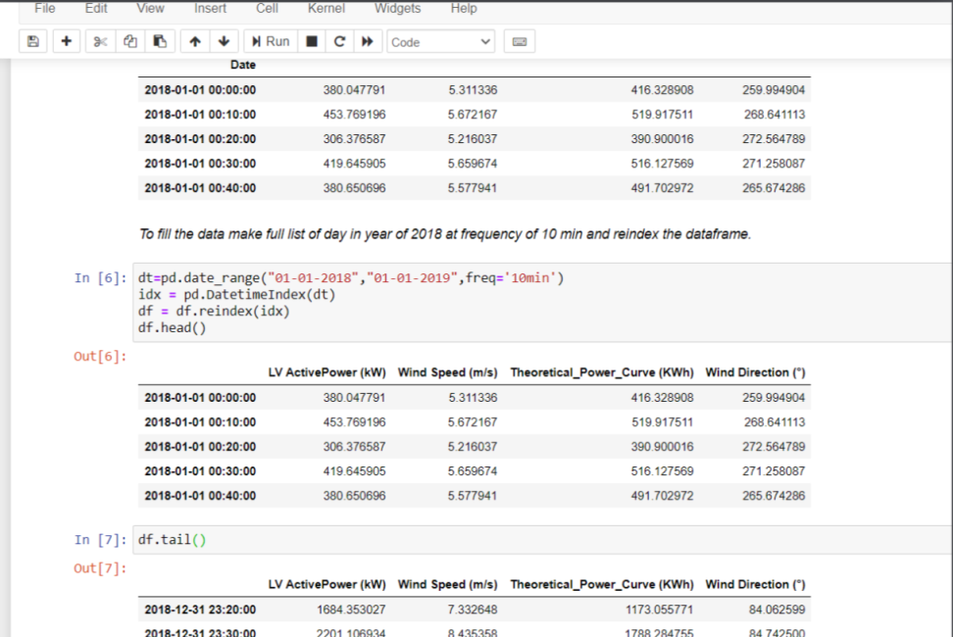
Handle Missing Data

Slide 15
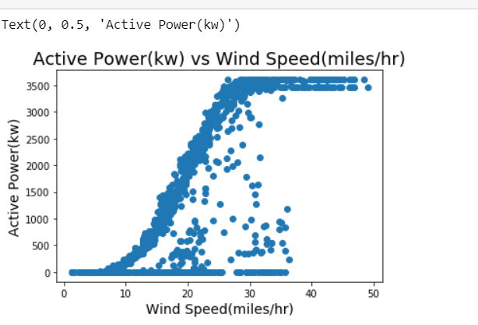
Visualization of the Data

Slide 16
Technology Stack used
Python
IBM Watson Studio
Pickle
Flask
Flutter
Heroku

Slide 17
Model Design
Deciding parameters or features
(Windspeed,temperature,Humidity,pressure)
Separating Training and Testing data from the data set
Developing the model(LGBM Regressor)

Slide 18
Application Design
My initial plan is building the web app in Node-RED, but we wanted to provide our end-user the solution in single click, so we switched from Node-RED Web app to Android Application. We used Flutter framework for designing the UI of the app and Flask for the back-end.

Slide 19
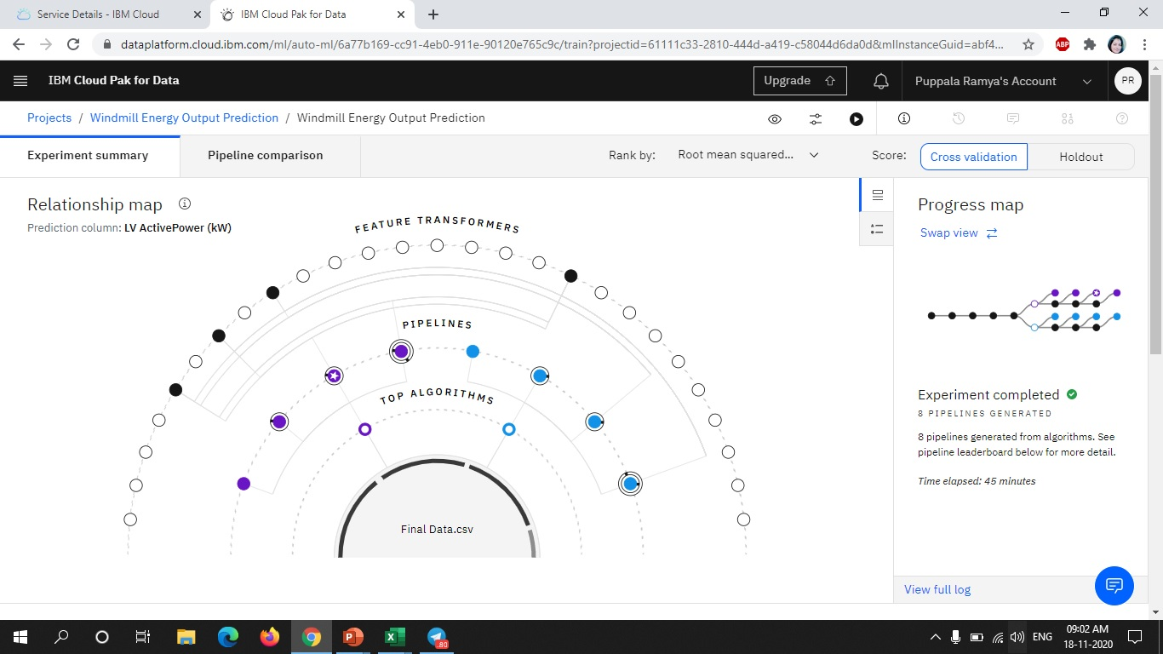
Watson Studio (Auto AI) Relationship Map

Slide 20
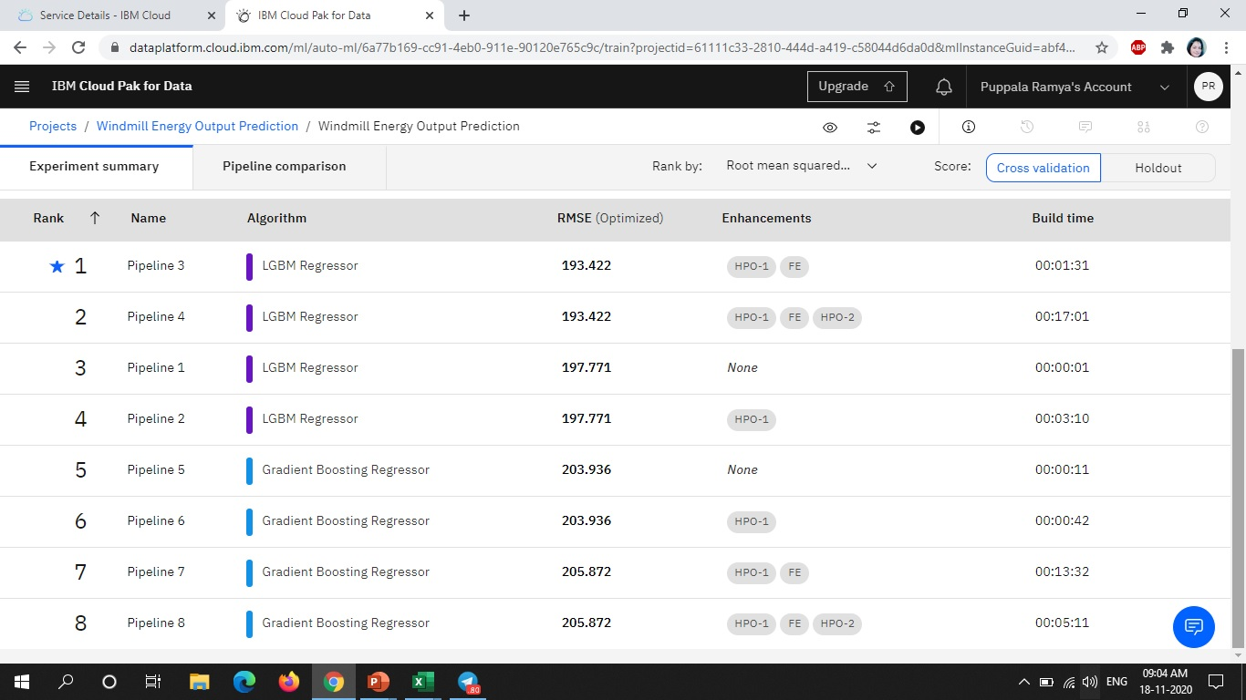
Watson Studio (Auto AI) Pipeline leaderboard

Slide 21
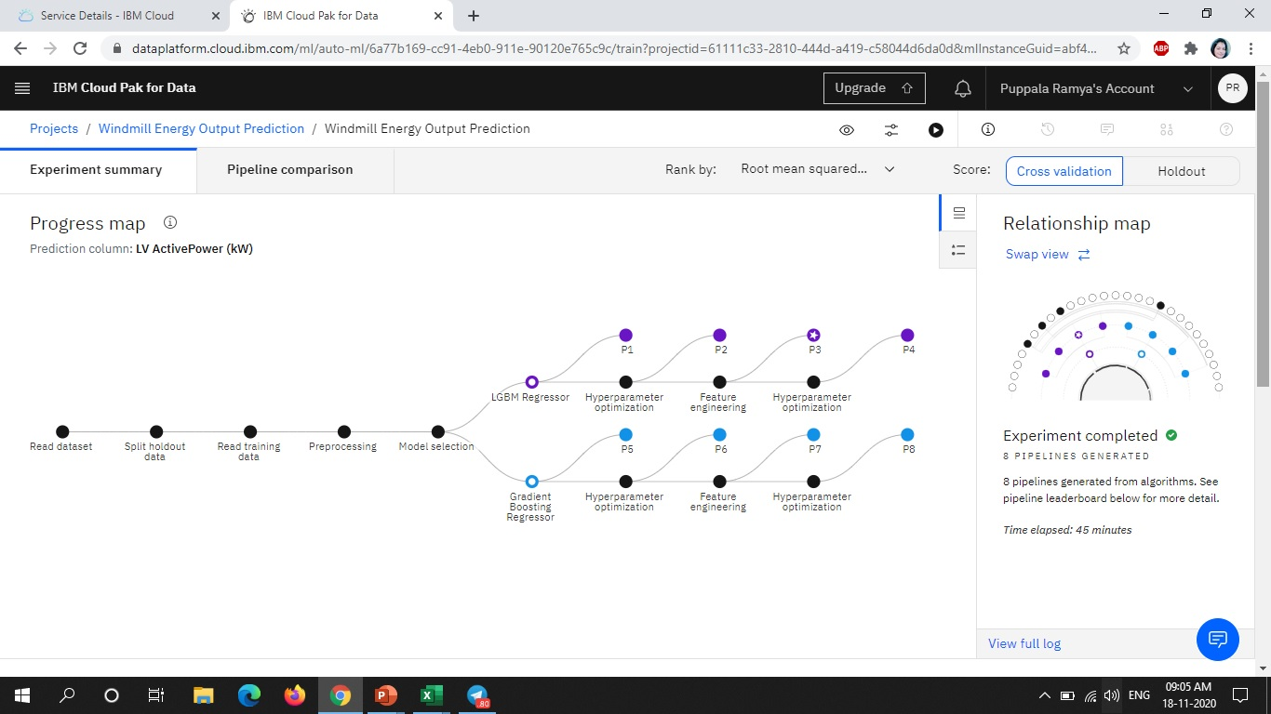
Watson Studio (Auto AI) Progress Map

Slide 22
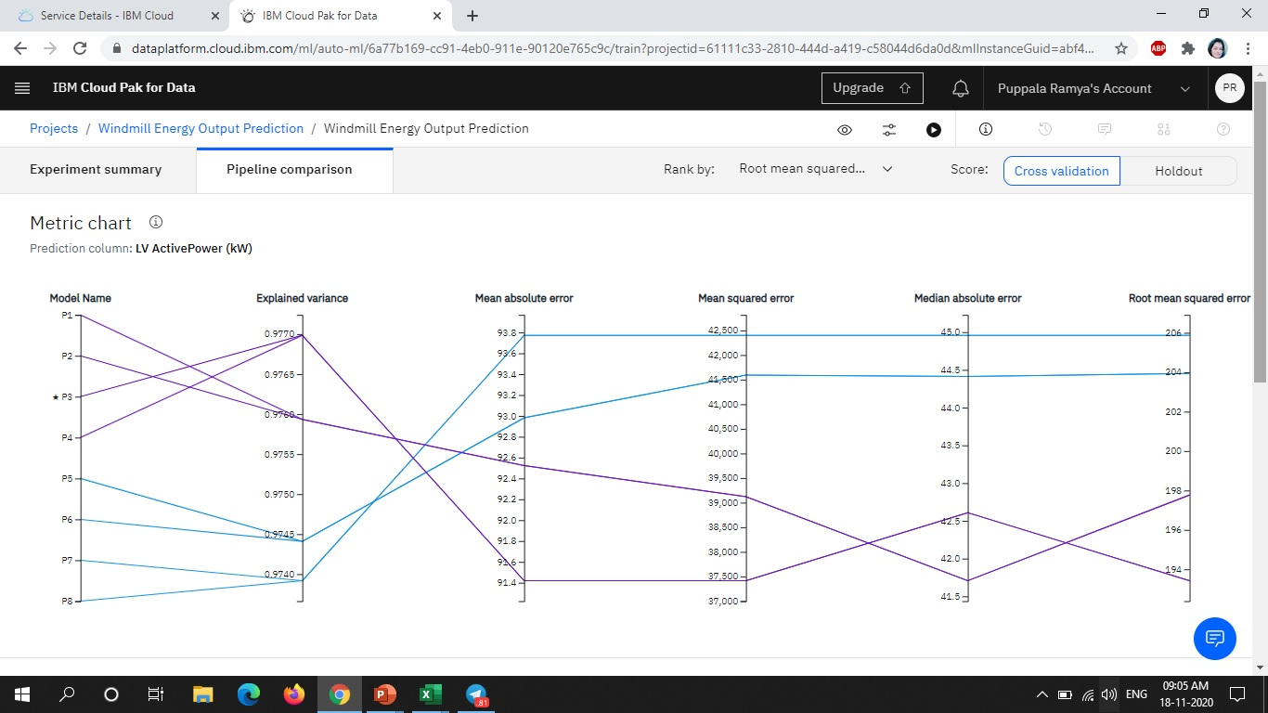
Watson Studio (Auto AI) Metric Chart

Slide 23
Advantages
Weather Underground Services provide very accurate Historical Weather Data which increased the accuracy of model.
Mobile App is more convenient to use rather than web apps.
On giving location permissions, app can accurately predict power output at your live location

Slide 24
Disadvantages
Weather API is paid and the free version provide limited API requests per day.
Android App can't be deployed on IBM Cloud.
No free server available on IBM Cloud for deploying Backend.

Slide 25
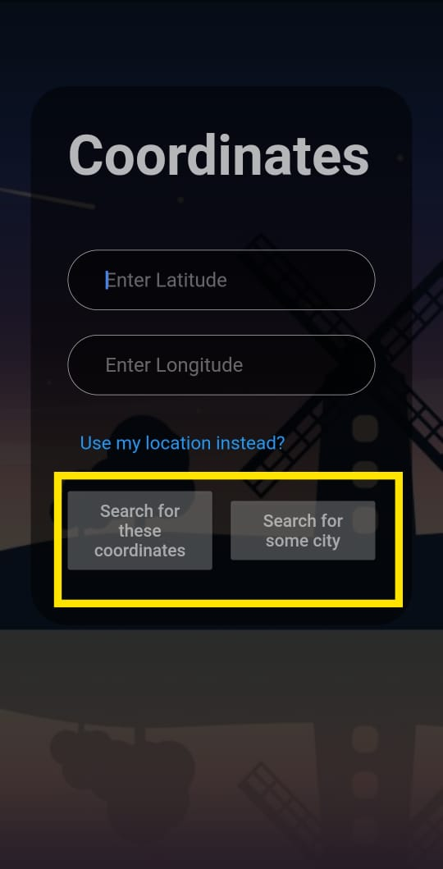
Features of App
provide wind energy output prediction just by knowing the coordinate of location, name of the city or your current location

Slide 26
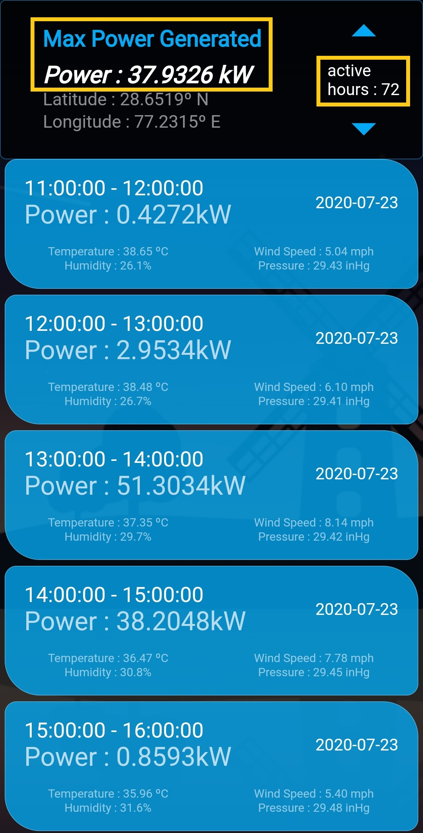
Provides wind power output prediction of upcoming 72 hours

Slide 27
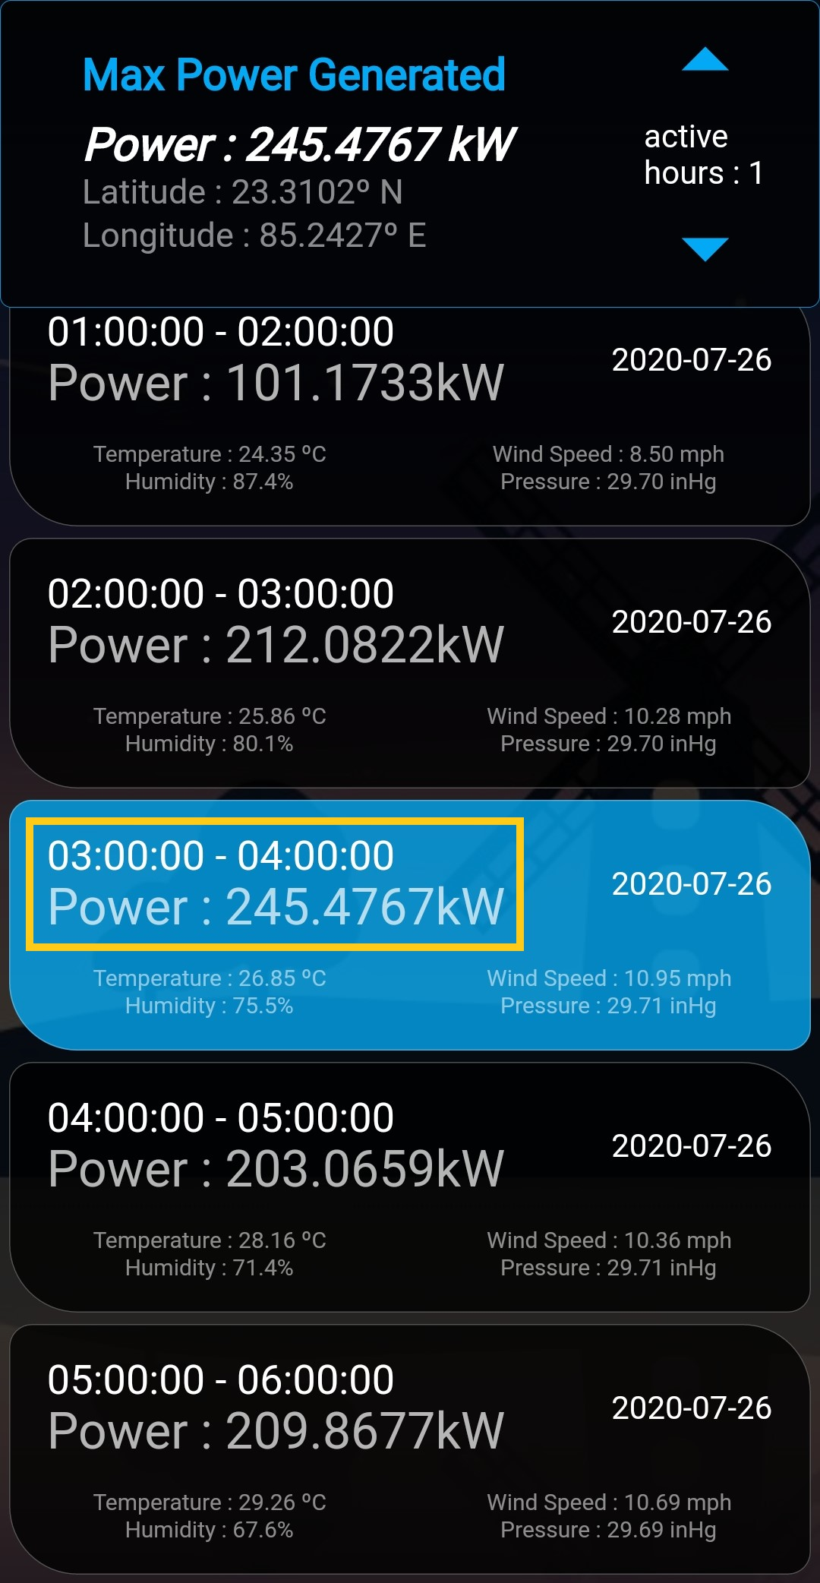
Display Best Utilisation Time and output power of wind turbine

Slide 28
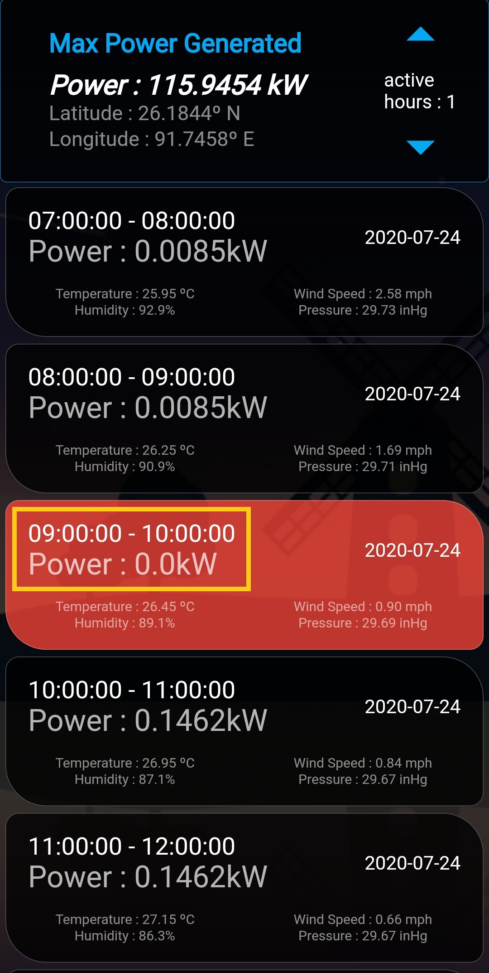
Display worst Utilization time for operating wind turbine

Slide 29
Conclusion
In this project, I used Weather Underground services (subsidiary of IBM) to get accurate historical weather data. I analyzed several ML models, and chose LGBM Regressor to develop this model.
This project gave us deep insight about the Flutter framework. I integrated the app with model and Weather API using REST API and Flask Back-end.
The accuracy of LGBM Regressors model for this project is 95%.

Slide 30
Future Scope
Gmaps Google API
Speech to Text IBM Cloud Service

Slide 31



